Slide 1
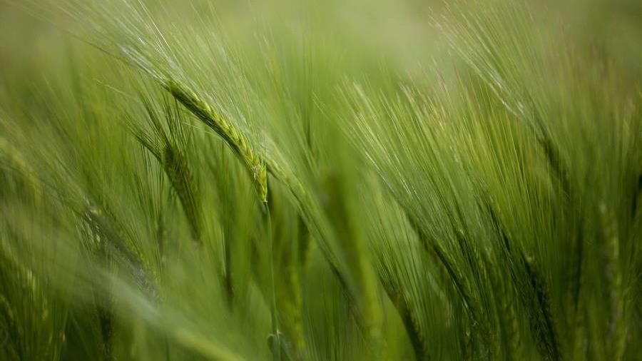

Summerseat Village Collective
AGM

Slide 2
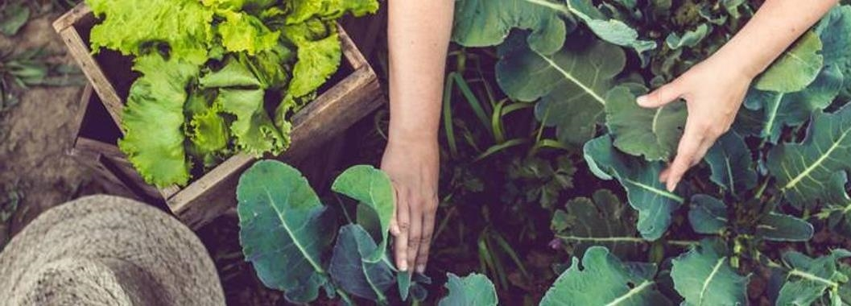

About us
Summerseat Village Collective is run by volunteers and exists to raise funding through bids for projects which aim to improve the environment in the village of Summerseat near Bury, benefitting not only residents, but wider communities across Bury.

Slide 3

AGM AGENDA
2024
Project Updates
Thanks to Mike and Eileen
Thanks to all volunteers
Bid activity
Island works update
Future Priorities
AOB/DBS checks

Slide 4
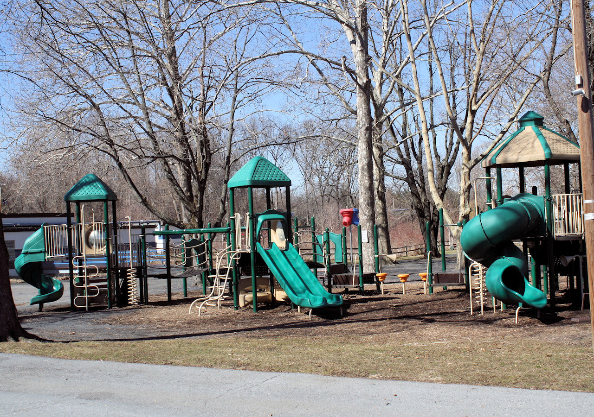
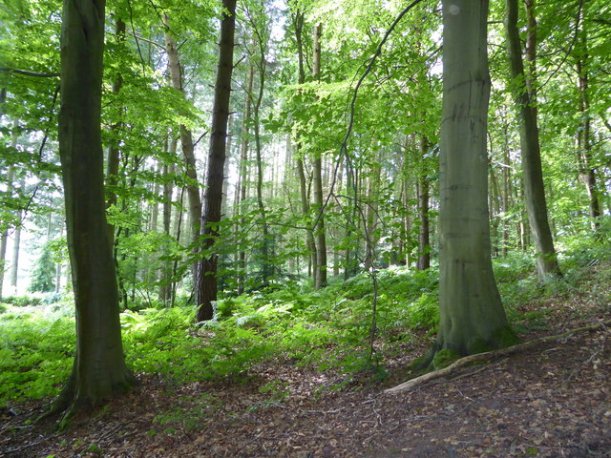
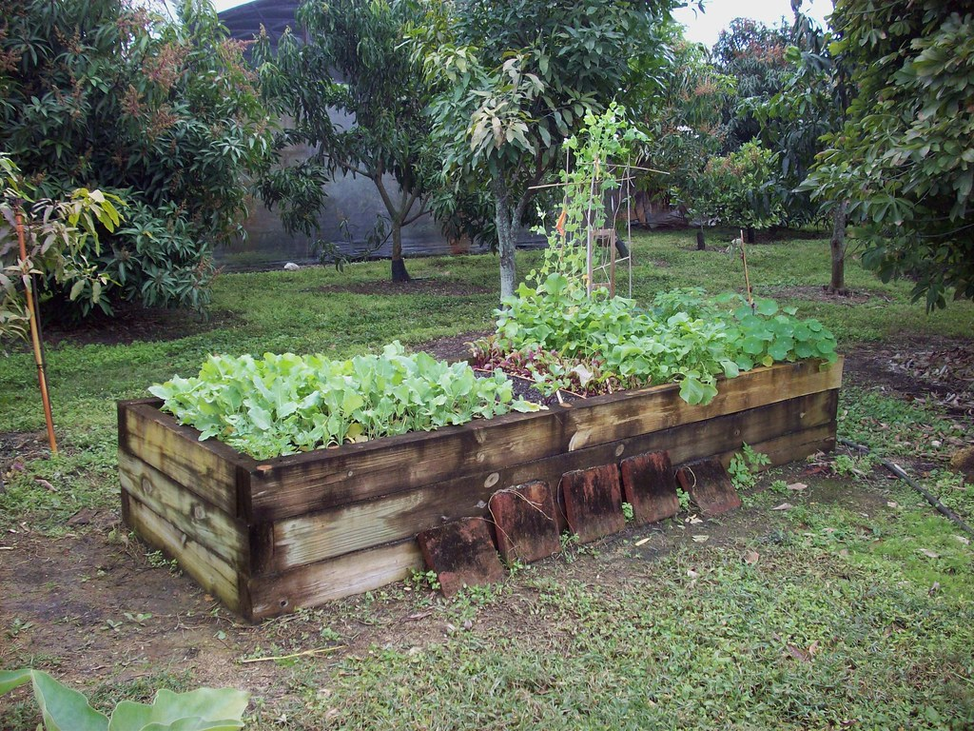
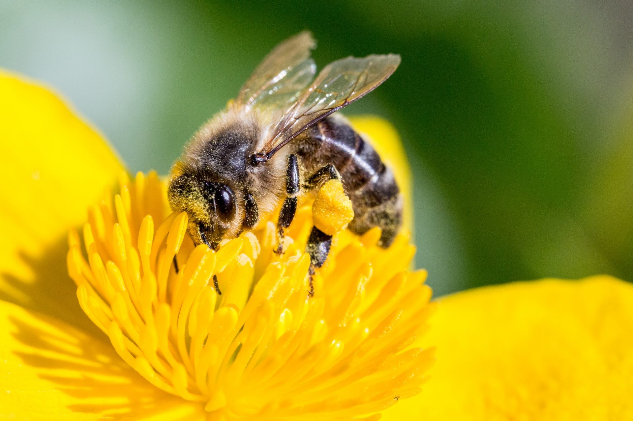
Summerseat Village Collective overview
THE ISLAND PROJECT
THE BEES
The park Project
THE VEG BEDS, Wildflowers –Eileen & Mike
The Group has secured £307k of funding from a local trust to make the island more accessible and increase outdoor project delivery.
Again, partnered with Proffitts and Bury Council.
The Bees are just becoming more active, and the group are now looking at funding streams to pay for workshops with schools in the borough.
The group worked together to gain funding for a new park and daily mile path. Partners were Proffitts and Bury Council.
Eileen has continued to work hard on the Veg beds and with the school children.
Mike has continued his work on the Island and has made tremendous progress. Thank you to both.

Slide 5
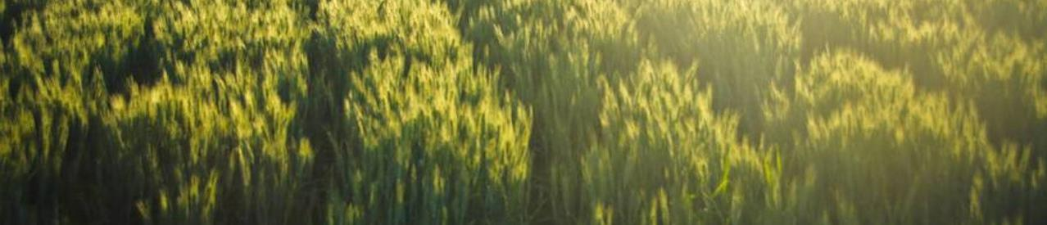
Bids Applied FOR 2023
£307k
Local Charitable Trust
£30,000
£50,000
Greater Manchester Green Spaces Fund
Unsuccessful
Local Community Fund – Bury Council
Unsuccessful
Gained funding to make the Island more accessible for all
Successful!
5

Slide 6
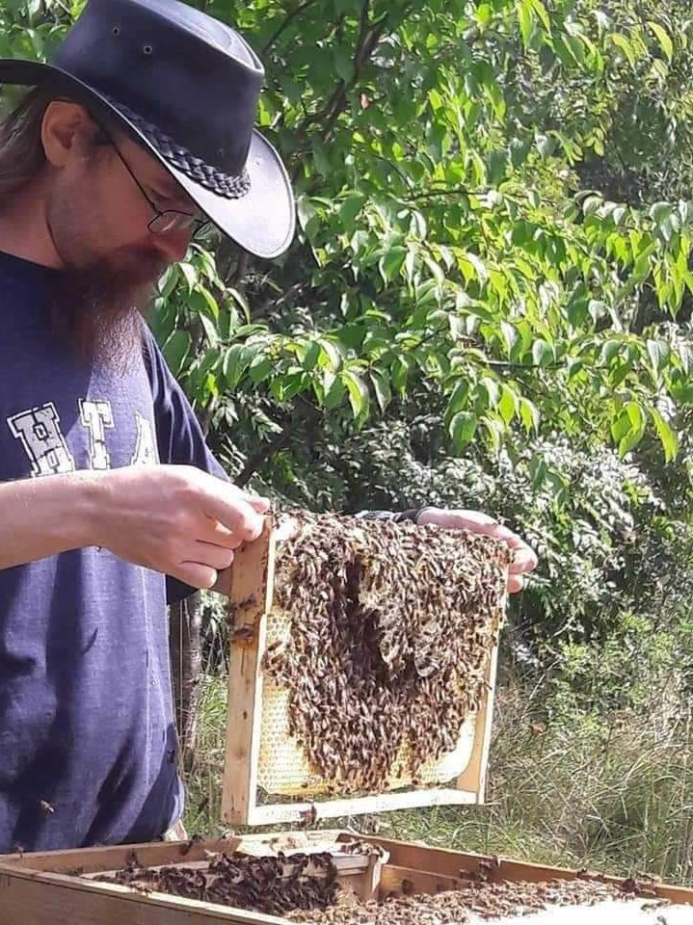
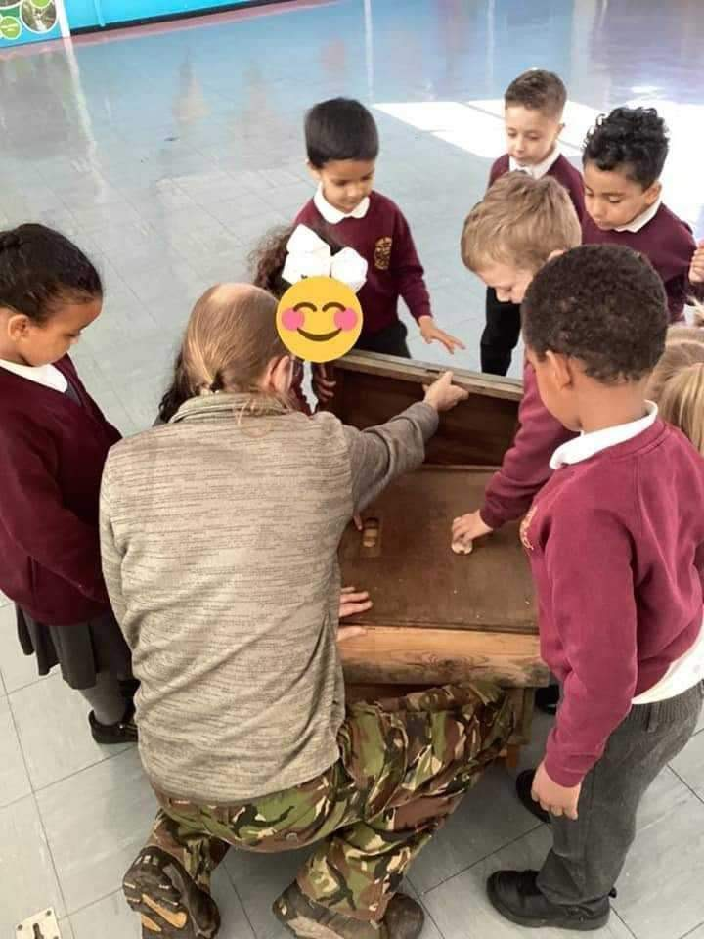
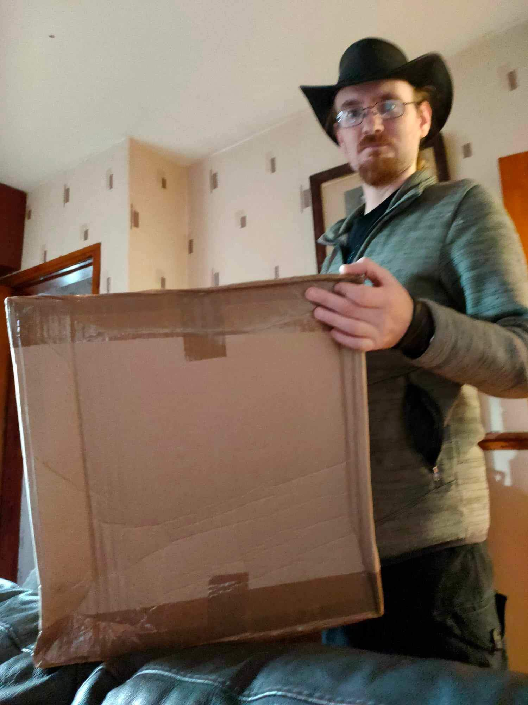
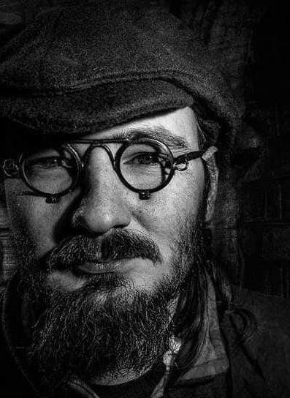

Lee Fairhurst
Island Land Manager

Slide 7
Island Programme of Works
Project Milestones | Apr-24 | May-24 | Jun-24 | Jul-24 | Aug-24 | Sep-24 | Oct-24 | Nov-24 | Dec-24 | Jan-25 | Feb-25 | Mar-25 | Apr-25 | May-25 | Jun-25 | Jul-25 | Aug-25 | Sep-25 | Oct-25 | Nov-25 | Dec-25 | Jan-26 | Feb-26 | Mar-26
 | Month 1 | Month 2 | Month 3 | Month 4 | Month 5 | Month 6 | Month 7 | Month 8 | Month 9 | Month 10 | Month 11 | Month 12 | Month 13 | Month 14 | Month 15 | Month 16 | Month 17 | Month 18 | Month 19 | Month 20 | Month 21 | Month 22 | Month 23 | Month 24
Key milestones of the project and when they will take place
Funding / grant secured
Masterplan finalised
Funding / grant part paid - 4 payments | £33,327 |  |  |  |  |  | £150,927 |  |  |  |  |  | £94,531 |  |  |  |  |  | £28,215
Order topographical survey
Order arboricultural survey
Order Ecological survey
Plans shared with community
Tender documentation produced
Work oout to tender
Tenders received
Contractors start work:
Site set up and clearance
Paths and surfacing
Boundaries
Pump Track
Features
Softworks
Bee workshops
Celebration event
Formal Project Evaluation

Slide 8


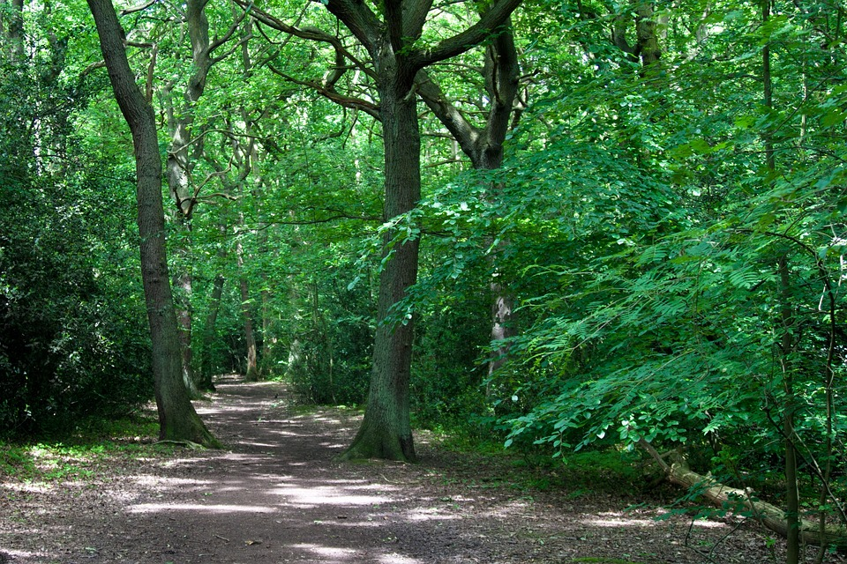
Future Priorities
New Call for Volunteers and Members.
Bids to fund Bee Workshops for Schools and the wider Collective.
First progress report for Island Funder due in October.
Engage young people and wider community in various stages of the Island development
Explore more income generation activities – Bee experiences and workshops.

Slide 9

AOB

